Slide 1

Improving the Diagnostic Process
Moderator:
Gordon Schiff, MD
Associate Director Center for Patient Safety Research and Practice
Brigham and Women's Hospital Div. General Medicine
Safety Director – Harvard Center for Primary Care Academic Improvement Collaborative
Associate Professor of Medicine Harvard Medical School

Slide 2

IOM Report September 2015

Slide 3
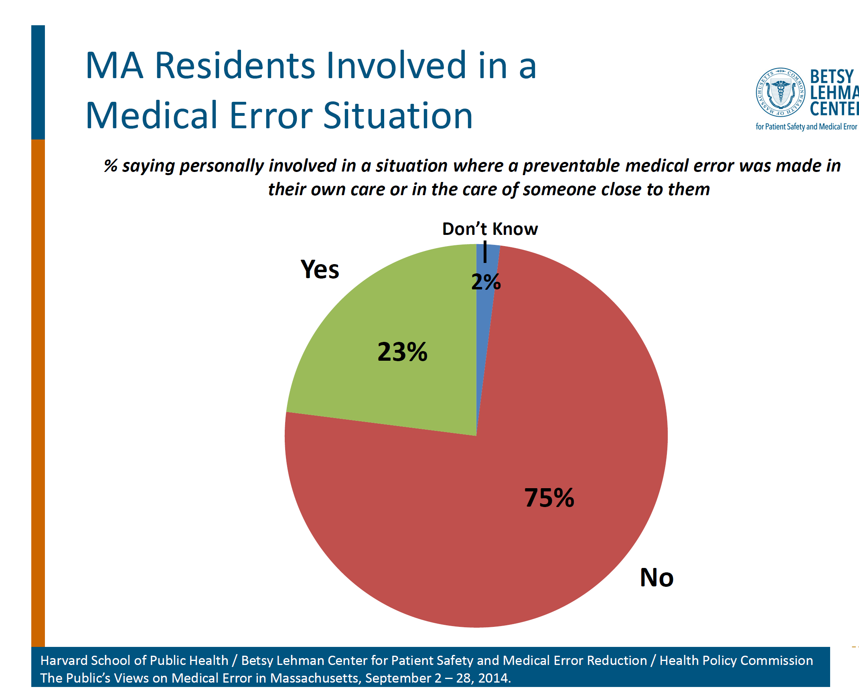

Slide 4
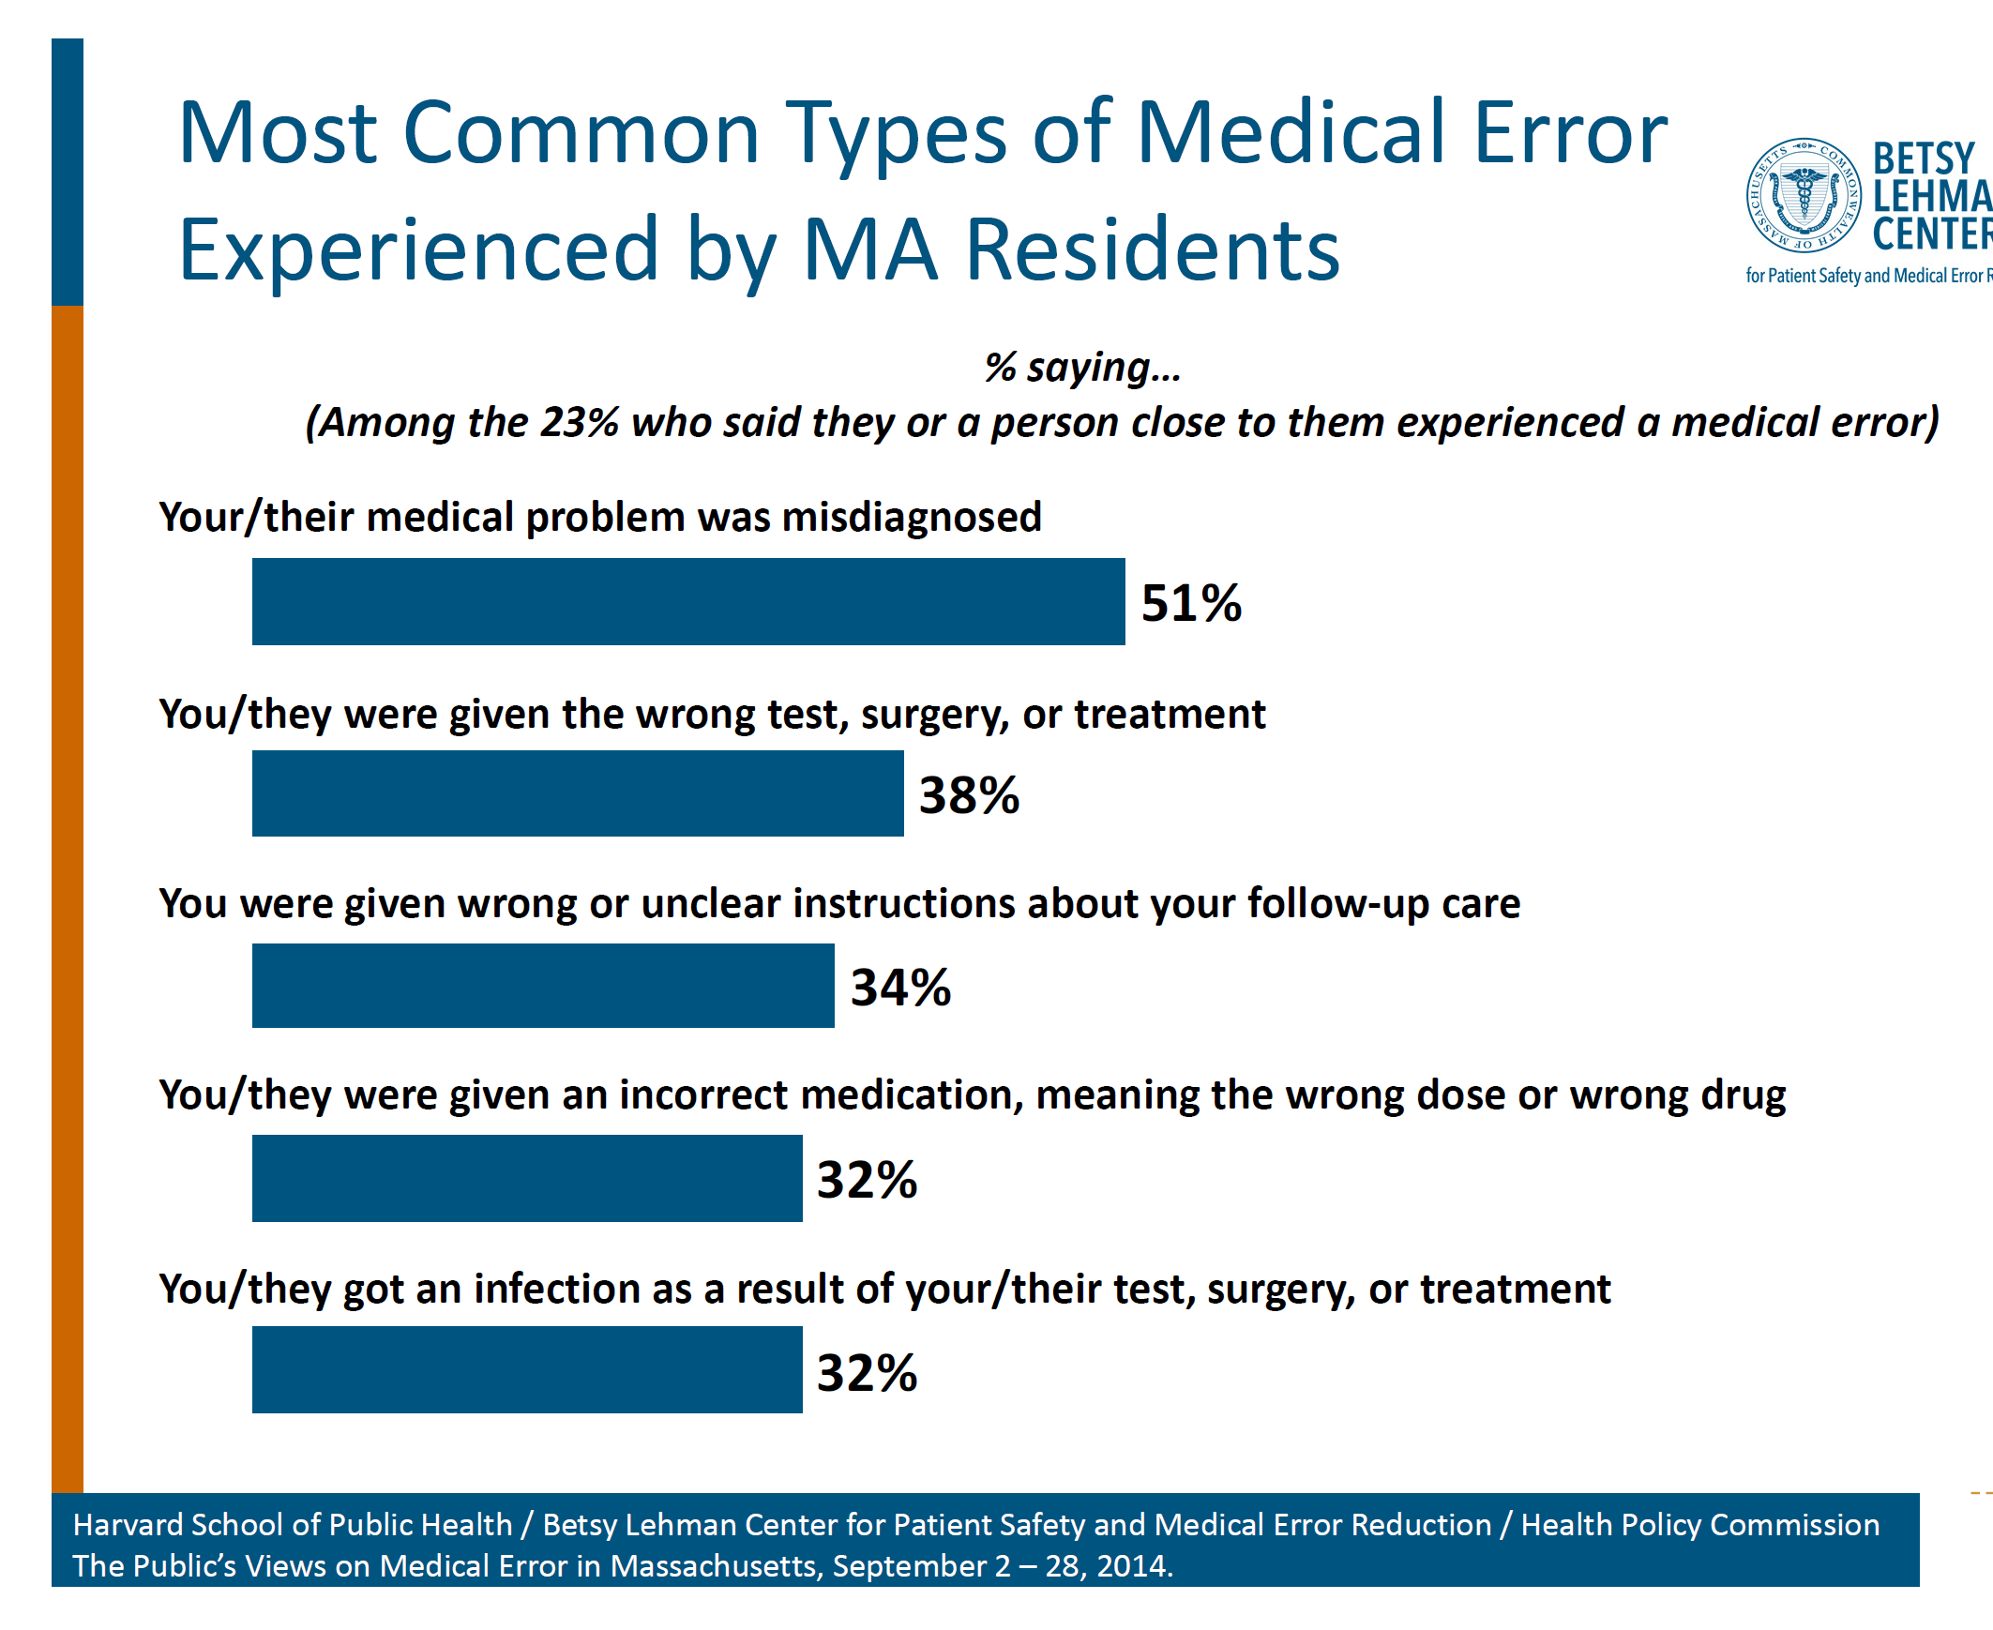

Slide 5
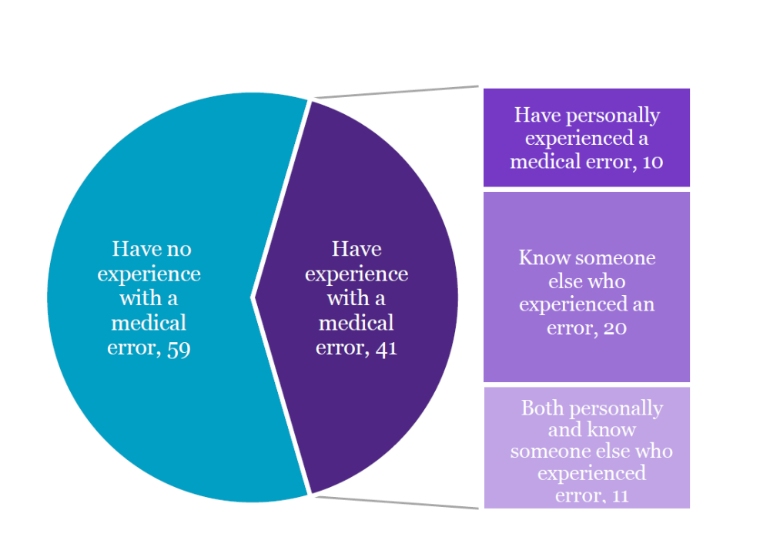

21% Experienced Medical Error
IHI/NPSF 2017 Survey

Slide 6
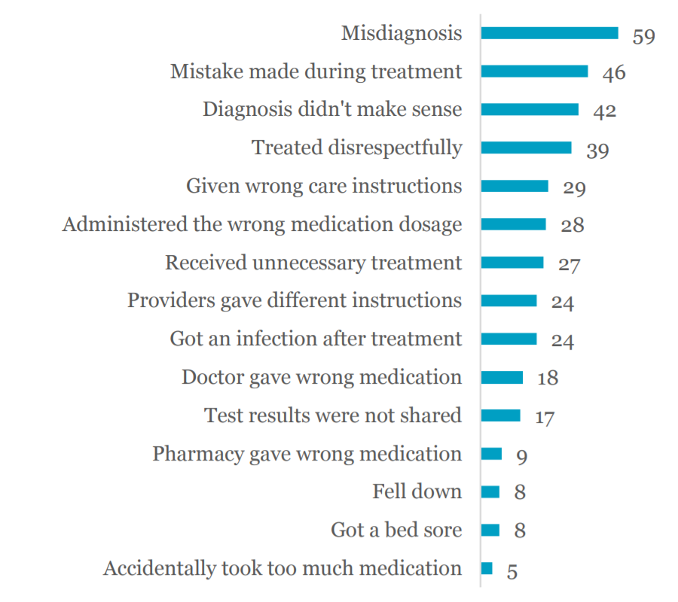


Misdiagnosis
Leading
Type of Error

Slide 7
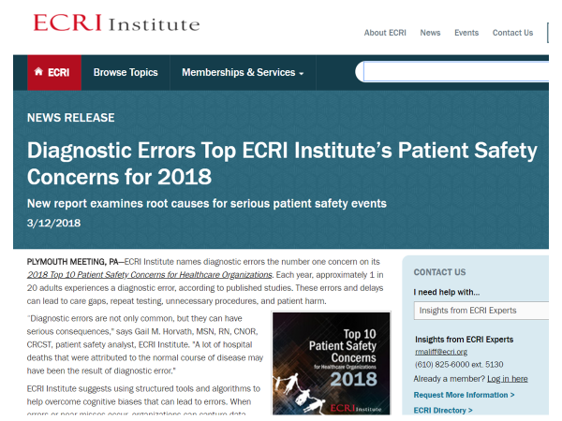

Slide 8

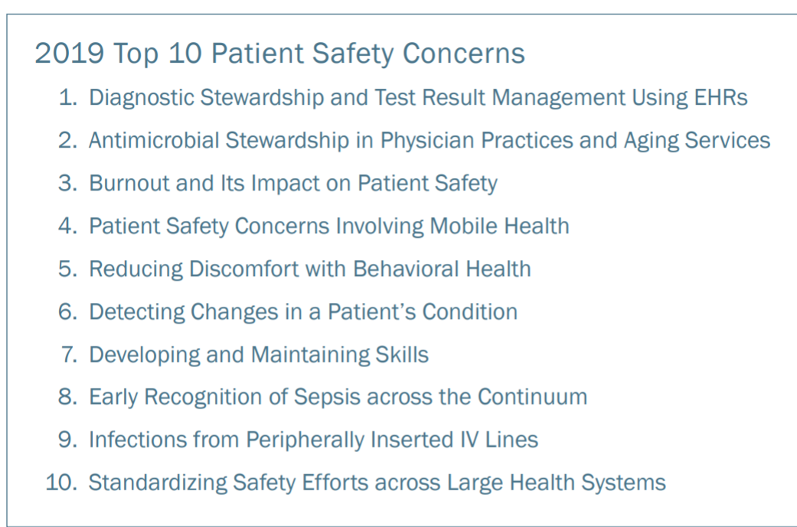
3/11/19

Slide 9
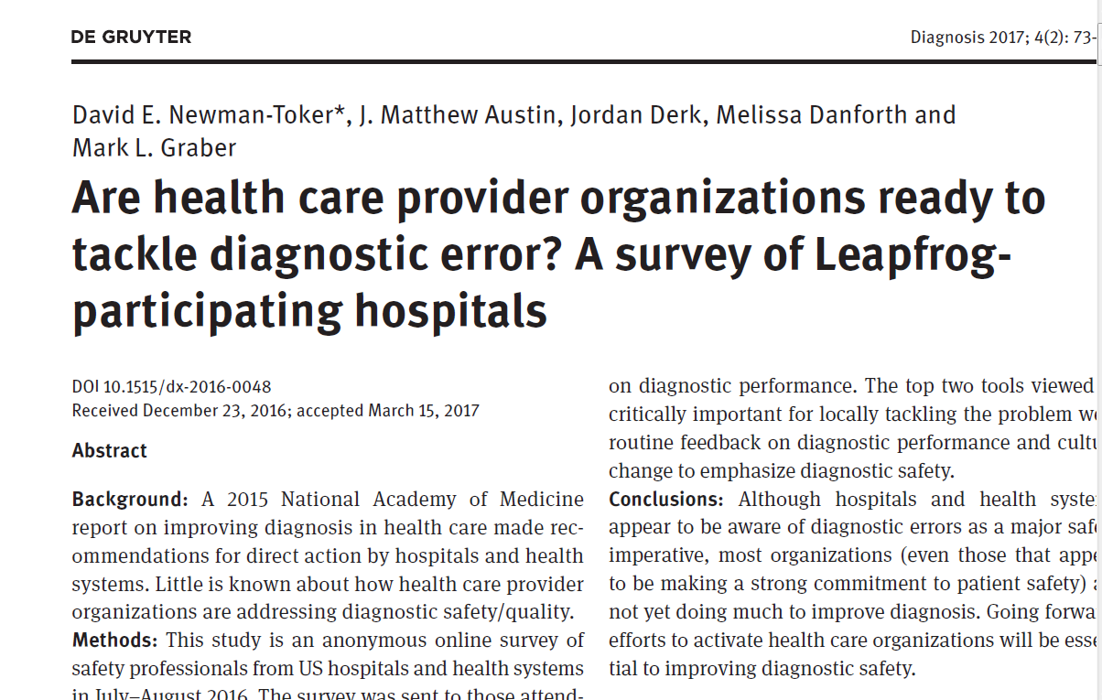

Slide 10
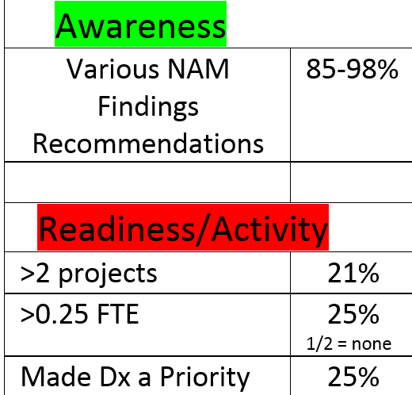
Leap Frog Town Hall Call: Ready to Tackle Diagnostic Error? N=61

Slide 11













Slide 12
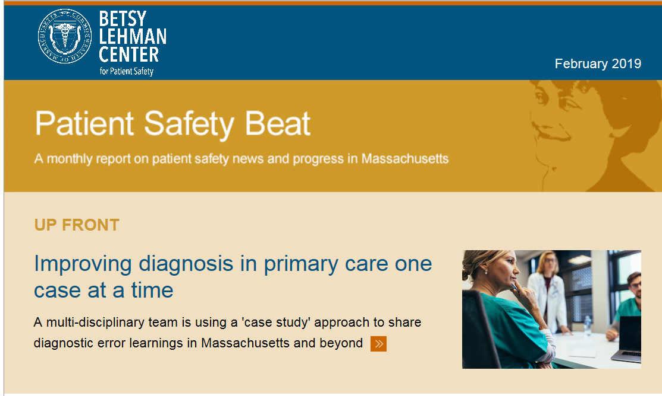
PRIDE Network

